Slide 1
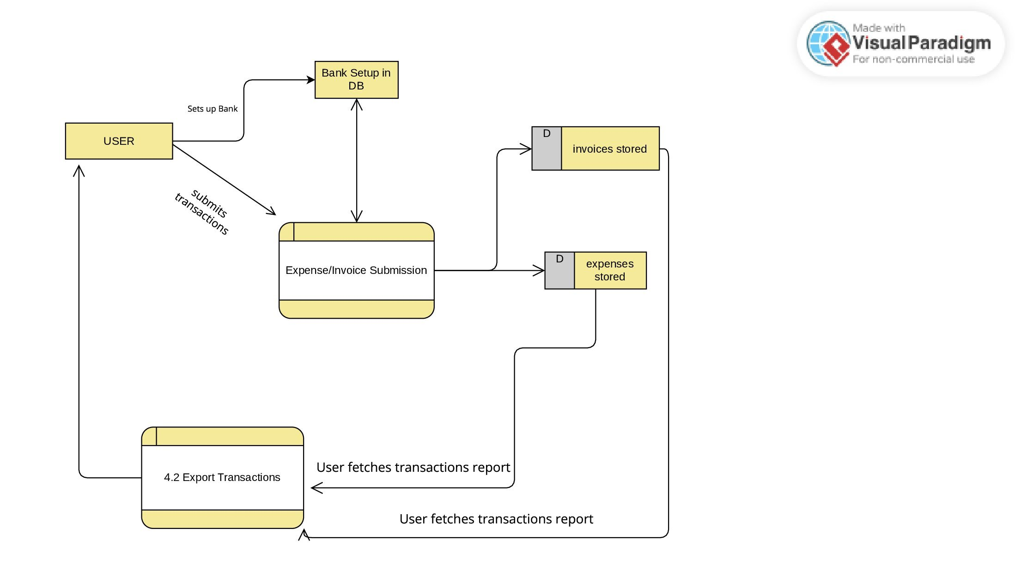
4.3 Export Transactions Report

